Slide 1
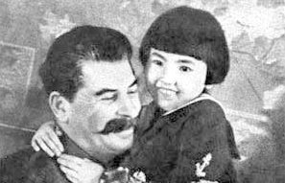

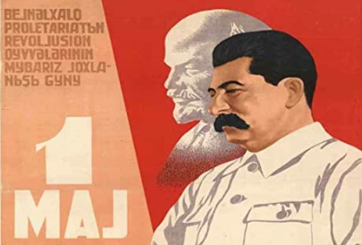
The Rule of Josef Stalin
By 1928 Lenin was dead and Josef Stalin was in the driver’s seat:
Not yet dictator, rather first in a coalition of equals who agreed only that Leon Trotsky should not be their boss
But Stalin outmaneuvered his peers
Lenin had failed in the principal task of any leader who wants to lead a durable movement: succession planning
Thus the Party would, somehow, choose his successors
And Stalin was General Secretary, in charge of personnel…
Executed his rivals
Not foreordained that the USSR would turn into a terror-ridden prison camp, but once Stalin was in command, the odds were high
3:45 of audio in this slide; 14:45 in this slide group
Notes:
By 1928 Lenin was dead and Josef Stalin was in the driver’s seat.
Lenin had lived for only half a decade after his revolution. In May 1922 Lenin had suffered a stroke, but he was back on his feet and in his office by July. In December 1922 he had suffered a second stroke. In March 1923 he had suffered a third stroke and temporarily lost speech: he did to really recover. In January 1924 he fell into a coma and died.
In his illness he had written out what he thought of his probable successors at the head of the dictatorship. He did not think much: Josef Stalin “is too coarse… this defect… becomes intolerable in a General Secretary.… Comrades think about a way of removing Stalin… appointing another man… more tolerant, more loyal, more polite and more considerate…” Leon Trotsky “is personally perhaps the most capable man… but has… excessive self-assurance and shown excessive preoccupation with the purely administrative side…” Felix Dzerzhinsky, Sergo Ordzhonikidze had displayed “Great Russian chauvinism…” Et cetera, et cetera. Thus Lenin, as he failed, refused to use his prestige to anoint a leader or leaders. He refused to set up mechanisms by which the will of the people, or even of the industrial proletariat, or even of a broad grassroots or semi-grassroots group that could be ascribed the power of representation the industrial proletariat could be ascertained.
The party would choose its own leaders, somehow.
As General Secretary, in charge of personnel, Josef Stalin determined who would be the party.
It is no surprise that Stalin came out on top, in the process acquiring many real enemies. It is not surprising that a paranoid personality like Stalin with many and powerful real enemies then took the next steps as soon as he felt he could: silencing, then executing all of his former peers; and promoting to the second rank of power people utterly dependent on him who served—who kept their lives—at his whim.
Dzerzhinsky died of a heart attack in 1926 before Stalin had consolidated power. Stalin shot all the others mentioned in Lenin’s testament, save for Trotsky, and perhaps Ordzhonikidze. Perhaps Ordzhonikidze managed to shoot himself before the secret police could. We do not know.
There might have been another path. It was not foreordained that the Soviet Union would turn into a terror-ridden prison camp. But Lenin’s refusal to plan for succession or create mechanisms for any form of normal politics within the Communist Party meant that Russia was likely to fall back into an old political pattern, and acquire a Czar. And in a time of turmoil and troubles, a Czar was likely to behave like Dread Ivan IV Rurik—“Ivan the Terrible”. The Czar they got was Josef Stalin: a paranoid psychopath, and one of the lead candidates for the greatest mass-murderer in human history.
Lenin appointed Stalin “General Secretary”—responsible for personnel and other bureaucratic matters—of the Communist Party. It was seen by Lenin and his inner circle as a simple boring job, for someone with a good work ethic and committed to the party, but otherwise without great gifts. It was part of the simple administration of things rather than of the government of men.
Recruitment drives brought the party membership up to one million in 1929, with new members selected and screened by the party. The General Secretary—Stalin—appointed local committee secretaries. Local secretaries appointed those who screened incoming members. Local secretaries chose the delegates to the Communist Party Congresses—who would then do as their patron’s patron suggested. And their patron’s patron was Stalin.

Slide 2
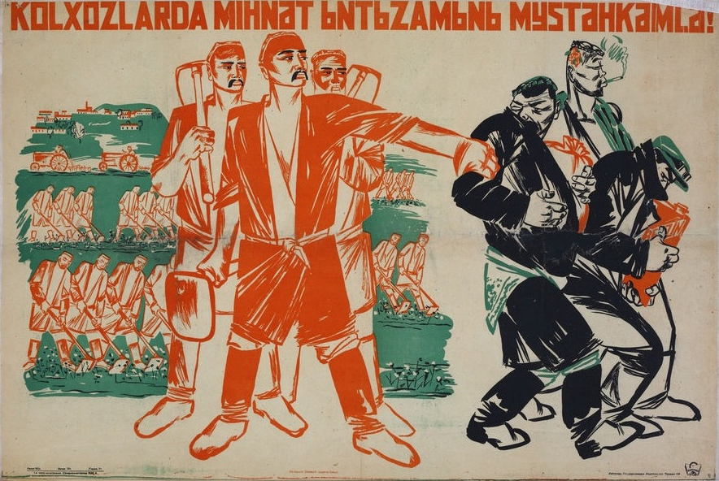
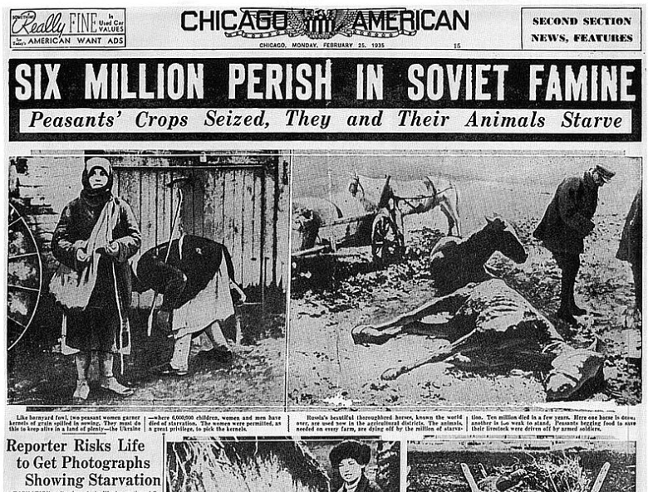
The Reenserfment of the Peasantry
Take Marx’s critique of Britain’s path to industrialization as a business model:
Russia invaded five times by four powers in four centuries
Each invasion had posed an existential threat to the regime, and perhaps to the country and its unity
Lenin and Stalin were sure that they posed an existential threat to the business class and its puppet politicians worldwide
Lenin and Stalin believed they needed to industrialize fast
Only then could they supply an army to fight off the future invasion(s)
They were not wrong
Collectivization of agriculture by terror-famine
Then use state power to squeeze peasant standards of living as low as possible
An extremely brutal disaster
But it did gather resources for industrialization
4:45 of audio in this slide
Notes:
The first imperative was destroying the market and private property. The second imperative that Lenin had thought he faced—and Stalin agreed—was to industrialize as quickly as possible. They greatly feared that the capitalist powers of the industrial core would decide to overthrow their regime.
The Bolsheviks thought that they were viewed by the non-socialist powers as an existential threat. And a Russia that had not been regarded as an existential threat had been invaded five times in the previous four centuries: the Crimean Tartars in the 1500s, the Poles in the 1500s and 1600s, the Swedes trying to conquer early in the 1700s when Peter the Great was Czar, Napoleon trying to conquer early in the 1800s when Alexander I was Czar, and now World War I. All four had come too close to ending Russia as a great power for comfort.
Someday soon the really-existing socialist regime might have to fight a war to survive. They had already fought two: a civil war, in which Britain and Japan had at least thought about making a serous effort to support their enemies; and a war against Poland to the west. The were desperately aware of their economic and political weakness. They needed to build industry.
Lenin and Stalin were not wrong here.
On June 22, 1941 Nazi Germany was to attack the Soviet Union with all its strength. Its war aims were two:
1. to exterminate Jewish Bolshevism as an idea, a political movement, and a regime
2. to herd into reservations, enslave, or exterminate the inhabitants of the Soviet Union. The land they occupied was needed to provide larger farms for German farmers and more “living space” —Lebensraum—for the German nation.
All the Bolsheviks agreed that Russia needed to industrialize rapidly. But how are you to persuade the peasants to boost agricultural production if you have no factory-made consumer goods to trade them for their grain? There was a “scissors crisis”: farm prices were too high, and the prices peasants were willing to pay for urban manufactures were too low for both the cities to be fed and for enough manufactured goods to be kept in the cities to meet the government’s investment targets.
Stalin claimed that this “scissors crisis” was caused by a few bad-apple rich peasants who were holding back their grain in order to extort unfairly high prices: the kulaks. The kulaks were the problem.
If there were to be no kulaks, no problem.
Stalin called for the reenserfment of the peasantry: the forced movement of peasants into communes run by bosses working for the state. This would, Stalin claimed, boost agricultural productivity massively: communes could realize economies of scale and build up agricultural machinery to a level impossible for a small farm. And the state could then set peasant standards of living as low as it wished, and so gather resources for rapid industrialization and urbanization. This process of industrialization would be guided by the planning process, calculating material balances for key commodities and rationing materials in scarce supply to the highest productivity uses.
Marx had interpreted the economic history of Britain as landlords using the political system to steal land from the peasantry, squeeze down their standard of living, force them to migrate to the cities to become a penniless urban working class, and use the resources from squeezing the peasant standard of living to build factories. For Marx this was a very bad thing: it was one of the things that made capitalism an obstacle to human development and flourishing. But the Bolsheviks took Marx’s critique of British modernization and took it as their business model.
In most economies, industrialization takes hold as better opportunities in the cities pull workers in from the countryside. There is no necessity for the peasantry to be starved, beaten, and pushed into the cities by making conditions in the countryside more miserable. But, Lenin might have and Stalin did reply, even if there was no economic-development necessity, there was certainly a politico-military necessity.
Some ninety-four percent of the Soviet Union’s twenty-five million peasant households were gathered into state- and collective farms, averaging some fifty peasants per farm. Peasants were shot, died of famine, and were exiled to Siberian prison labor camps in the millions during the 1930s. Perhaps fifteen million died. Agricultural production dropped by a third. The number of farm animals in the Soviet Union dropped by half.

Slide 3
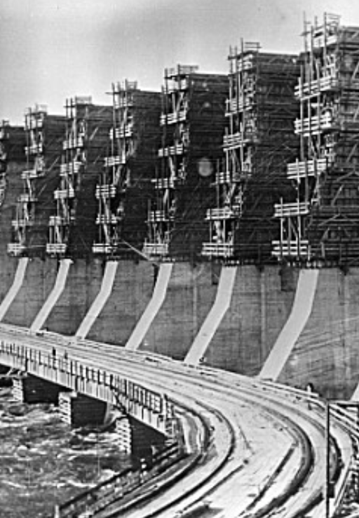
Rapid Industrialization
How do you run a planned economy?
Control a few hundred key commodities and their flows through material balances
Impose semi-military discipline
Make the rest of it factory managers’ problems
Hence they have to beg, borrow, buy, barter, and steal resources other than those tracked by material balances
Highly inefficient, highly corrupt
Exchange, barter, blat, and plan—understood as a desire to accomplish the organization’s primary goals—in a mixture
Note that this is not that different from the internal workings of a capitalist corporation in a market economy
The big difference is that efficiency is incentivized because a capitalist firm is always facing the make-or-buy decision
And a capitalist firm has a hard budget constraint: input and output prices govern its decisions
Thus really-existing socialism mammothly inefficient
3:45 of audio in this slide
Notes:
Having first condemned his political opponents as unrealistic “super-industrializers,” Stalin announced a Five-Year Plan that exceeded even their hopes.
During the First and Second Five-Year Plans, Soviet statisticians claimed that industrial production—which had stood 11% above its 1913 level in 1928—was some 181 percent higher by 1933, and some 558 percent higher than 1913 by 1938. Heavy industry had the highest priority: coal, steel, chemicals, and electricity. Consumer goods were to come later, if at all.
The “Plan” was a series of selected objectives—finish this dam, build so many blast furnaces, open so many coal mines—to be achieved whatever the cost. When in the mid-1960s Fidel Castro decreed that Cuba was to make a ten-million ton sugar harvest, nearly twice its normal production, and that everything else was to be subordinated to that goal, he was acting in the spirit of Stalin’s Five Year Plans. The aim was to build up heavy metallurgy. The task was to acquire—buying from abroad or making at home—the technology that American heavy industry deployed. A “steel city” was to be built in the Urals, at Magnitogorsk, and supplied with coal from the Chinese border. WITH Magnitogorsk it is hard to see how Stalin could have won World War II, for the factories of western Russia were under German occupation from July 1941 until late in 1943. Dams, automobile factories, tractor (or tank) factories—all located not near the border or where the people were but far to the east of Moscow. General Motors, Ford, and Caterpillar were eager to contribute engineering expertise for a price. How to get workers to man the new heavy industrial plants—especially since Stalin couldn’t pay them much: consumer goods were impossible to find with the shift to heavy industry, and agricultural production was in shambles. The answer was by drafting the population: internal passports destroyed freedom of movement, housing and ration books depended on keeping your job (and thus satisfying your employer), and there was always the threat of Siberian exile in a concentration camp or a bullet in the neck for those whose bosses accused them of “sabotage.” At the start of the industrialization drive, there were show trials of engineers (accused of being “plan-wreckers”).
Squeezing down the rural standard of living further produced a mass exodus: bad and low-paid as the cities were, for an adult male being a semi-serf on the collective farm was worse. More than twenty-five million people moved to the cities and the factories during the 1930s. The Soviet Union did outproduce Germany and Britain in war weapons during World War II—and many of the weapons were of acceptable quality. The T-34C tank was designed to last for six months, and for only 24 hours of intensive combat. That is how long they lasted during World War II operations, for the Nazis were good at spotting them and shooting at them.
On the other hand, the claims of nearly sevenfold growth in industrial production from 1913 to 1940 were significantly exaggerated. Perhaps industrial production in 1940 was (measured using standard techniques) 3.5 times industrial production in 1913. As best as Abram Bergson could estimate, Soviet real national product grew at some 4.5 percent per year on average from 1928 to 1958: impressive.

Slide 4
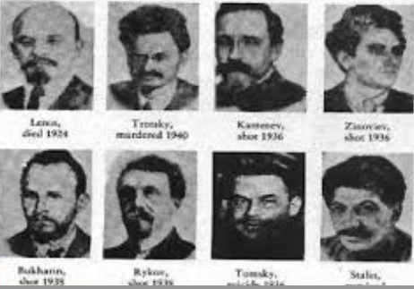
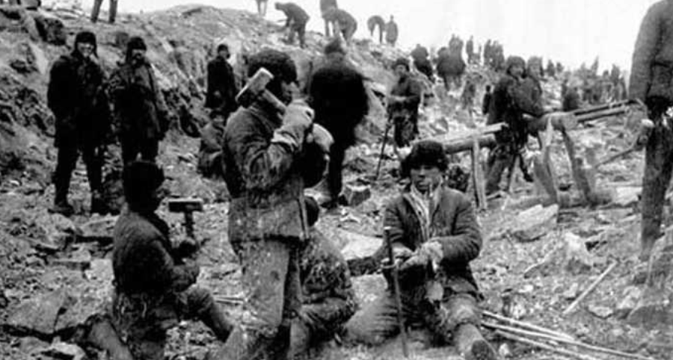
The Death of the Bolshevikii—& Others
The most dangerous thing to be in the 1930s was an Old Bolshevik member of the Central Committee:
Certainly more than 10 million deaths of ordinary people from famine and execution in Stalin’s purges and collectivization
But your greatest risk came if you were a member of the Communist Party
Especially if you had been a member early
Especially if you had been one of Lenin’s trusted lieutenants
The Gulag Archipelago—the network of prison camps
Few returned
Capable of holding millions
Filled five times:
Kulaks
1930s purges
1939 annexations
“Unreliable” ethnicities during World War II
Ex-prisoners of war after World War II
2:30 of audio in this slide
Notes:
But the butcher’s bill was immense. Factory workers were shot or exiled to Siberian labor camps for failing to meet production targets assigned from above. Intellectuals were shot or exiled to Siberian labor camps for being insufﬁciently pro-Stalin, or for being in favor of the policies that Stalin had advocated last year and being too slow to switch.
Communist activists, bureaucrats, and secret policemen fared no better. More than ﬁve million government ofﬁcials and party members were killed or exiled in the Great Purge of the 1930s as well. All of Stalin’s one-time peers as Lenin’s lieutenants were gone by the late 1930s—save for Leon Trotsky, in exile in Mexico, who survived until one of Stalin’s agents put an icepick through his head in 1940.
It is a grim historical irony that the most dangerous place to be in Russia in the 1930s was among the high cadres of the Communist Party. Of the 1800 delegates to the Communist Party Congress of 1934, less than one in ten were delegates to the Party Congress of 1939. The rest were dead, in prison, or in Siberian exile. The most prominent generals of the Red Army were shot as well. The Communist Party at the start of World War II was more than half made up of those recruited in the late 1930s, and keenly aware that they owed their jobs and their status in Soviet society to Stalin, Stalin’s proteges, and Stalin’s proteges’ proteges. We really do not know the butcher’s bill. We know more about how many cows and sheep died in the 1930s than about how many of Stalin’s opponents, imagined enemies, and bystanders were killed. We do know that the Siberian concentration camps were filled by the millions at least five times. The Gulag Archipelago grew to encompass millions with the deportation of the “kulaks” during the collectivization of agriculture. It was filled again by the purges of the late 1930s. It was filled yet again by Poles, Lithuanians, Estonians, Latvians, and Moldavians when the Soviet Union annexed those territories on the eve of World War II. Soldiers being disciplined, those critical of Stalin’s wartime leadership, and ethnic groups thought to be pro-German were deported during World War II. After World War II perhaps four million Soviet soldiers who had been captured by the Germans and survived Hitler were sent to the Gulag. There they rotted and died. The entire system would not be shut down until the late 1950s, when Nikita Khrushchev was General Secretary.

Slide 5
Preview
Communism and Fascism
Preview & review (5 min)
Administration (5 min)
Lecture: Alternatives to the ‘classical liberal’ laissez-faire order (5 min)
Lecture: Really-existing socialism (20 min)
Review (20 min)
Lecture: Tyranny (15 min)
Takeaways from this lecture (5 min)
Preview of the next lecture (5 min)

Slide 6
Takeaways from Last Time
From Climbing Out of the Great Depression: Lecture & Ch. 13
Monetary policy and the Great Depression: those countries that abandoned “orthodoxy” and concerns about inflation first and strongest were among those who did the best in pulling out…
Solidified the idea that the business cycle was not the weather—but that the government had a responsibility to at least try to maintain full employment
Expansion of the government’s role: if the government could and should stabilize employment at a relatively high level, didn’t that mean that the presumption that government should not do other things ought to be reconsidered as well?
The New Deal: Roosevelt trying everything and reinforcing apparent success; moved America left only because the center-right Hoover had been in power when the Depression started; elsewhere—to the great surprise of lefties—economic troubles shifted electorates and politicians right, rather than left

Slide 7
To Your iClickers
The Great Depression started when
Germany refused to make reparations payments in 1924, which led to a French occupation of Germany’s Rhineland provinces, which caused a European recession, which then snowballed
Britain returned to the gold standard in 1925, and then raised interest rates to support its high gold parity, which caused a recession in Britain, which then snowballed.
A stock market crash in the U.S. in the fall of 1929 caused a big recession in the U.S., which then snowballed
Expectations of a Democratic victory in the 1932 presidential election led to a collapse of investment in 1931 which caused a recession in the U.S., which then snowballed
None of the above.

Slide 8
Econ 115: Administration: Office Hours &c.
DeLong: Office Hours
M 11:10-12:40, Blum Hall 200B
T 11:15-12:00, Blum Hall 200B
By appointment in Blum Hall 200B, Evans 691A, or elsewhere: email <delong@econ.berkeley.edu> Sign up at: <https://www.icloud.com/numbers/0leoOOlezWp6BYKSiPJhdXy7Q>
Read: DeLong, chapter 11 & 12
Slides: <https://github.com/braddelong/public-files/blob/master/econ-115-lecture-8.pptx>
Do: Understanding the Great Depression <https://bcourses.berkeley.edu/courses/1487684/assignments/8052000>; due Mar 8
Memo: bCourses website <https://bcourses.berkeley.edu/courses/1487684>

Slide 9
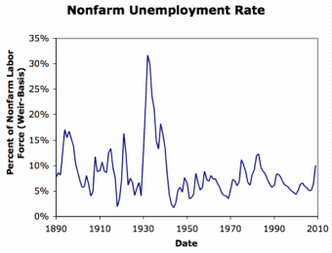
Alternatives to Let-It-Alone Market Society
Laissez-Faire Capitalism Failed in the Depression:
The aristocratic-landlord-military Old Order had bankrupted itself with WWI.
The financial-business Old Order bankrupted itself with its insistence on austerity and on the gold standard—“tough it out”
Socialists confidently predicted that capitalist breakdown would empower left-wing revolution
Their parties had grown with urbanization, industrialization, visible high inequality, and prosperity…
But by and large the swing was to the right, rather than to the left
Except in the United States

Slide 10
What Was the Alternative Going to Be?
Socialists thought that the alternative should be some form of communism:
Collective ownership and conscious management to avoid “irrationalities”
Nationalists thought that the problem was that the global international economy was run for the benefit of rich foreigners and parasitic financiers
Especially Jews
Proletarian nations that were unfairly deprived of resources and markets by imperial powers (like Britain, and France), rather than proletarian classes…
Let’s look at really-existing socialism first…

Slide 11
Karl Marx Thought
Complex, & not fully coherent…
The most revolutionary class…
The most revolutionary situation…
German philosopher, French activist, British economist
The logic of development of the capitalist economy
The even more revolutionary class
The New Jerusalem

Slide 12
Karl Marx Thought II
Marx thought he had proved:
As long as the existing system was not overthrown by one that nationalized and socialized the mans of production:
“The more productive capital grows, the more the division of labor and the application of machinery expands. The more the division of labor and the application of machinery expands, the more competition among the workers expands and the more their wages contract. [T]he forest of uplifted arms demanding work becomes thicker and thicker, while the arms themselves become thinner and thinner…”
“[Economic law] rivets the laborer to capital more firmly than the wedges of Vulcan did Prometheus to the rock... an accumulation of misery, corresponding with accumulation of capital. Accumulation of wealth at one pole is, therefore, at the same time accumulation of misery, agony of toil, slavery, ignorance, brutality, mental degradation... on the side of the [working] class.”
Fortunately for humanity, Marx further thought, his dystopian vision of what late capitalism would be would not be the end state of human history. The rule of the business class was creating and would create a truly prosperous society with:
“More massive and more colossal productive forces than have all preceding generations together... machinery, application of chemistry to industry and agriculture, steam-navigation, railways, electric telegraphs, clearing of whole continents for cultivation, canalisation of rivers, whole populations conjured out of the ground—what earlier century had even a presentiment that such productive forces slumbered in the lap of social labour?...
And then the rule of the business class would “produce... above all... its own grave-diggers”.
The workers would find it easy to organize.
The workers would find it obvious that treating the immense economic productivity of the value chain in which they and their skills were embedded as the private property of a single boss, or even a group of shareholders, was absurd:
“Centralisation of the means of production and socialisation of labour at last reach a point where they become incompatible with their capitalist integument. This integument is burst asunder. The knell of capitalist private property sounds. The expropriators are expropriated.”
Perhaps this happens from a democratic revolution that turns into a bloody social revolution.
Perhaps this happens from the free vote of a representative assembly with the interests of the masses at heart
But that was unlikely, for the rich were unlikely to passively surrender their property.
But it would happen

Slide 13
& After the Revolution?
Scant clues:
True freedom, with “individual property based on... cooperation and the possession in common of the land and of the means of production.”
This merely requires: “the expropriation of a few usurpers by the mass of the people.”
And then a democratic common plan for: “extension of factories and instruments of production owned by the State; the bringing into cultivation of waste-lands, and the improvement of the soil generally.”
Contribution “from each according to his ability.” Cf. Acts 11:29: “Then the disciples, determined to send relief unto the brethren which dwelt in Judaea, from each according to his ability” (“τῶν δὲ μαθητῶν καθὼς εὐπορεῖτό τις ὥρισαν ἕκαστος αὐτῶν εἰς διακονίαν πέμψαι τοῖς κατοικοῦσιν ἐν τῇ Ἰουδαίᾳ ἀδελφοῖς”).
Distribution “to each according to his means.” Cf. Acts 4:35: “The proceeds were laid down at the apostles’ feet: and distribution was made to each according to his need” (“καὶ ἐτίθουν παρὰ τοὺς πόδας τῶν ἀποστόλων· διεδίδετο δὲ ἑκάστῳ καθότι ἄν τις χρείαν εἶχεν”)

Slide 14
It Didn’t Happen That Way
So what were socialists to do next?:
“Individual property based on... cooperation and the possession in common of the land and of the means of production.”
“The expropriation of a few usurpers by the mass of the people.”
And then a democratic common plan for: “extension of factories and instruments of production owned by the State; the bringing into cultivation of waste-lands, and the improvement of the soil generally.”
“From each according to his ability.”
“To each according to his means.”

Slide 15
Review: Your iClickers
World War I started when:
Austria-Hungary attacked Serbia on August 1, 1914; Austria-Hungary declared war on Russia on August 3; Germany attacked Belgium on August 6; and Germany declared war on Russia on August 12
Britain attacked Belgium on August 1, 1914; Germany declared war on Britain on August 3, 1914; Austria-Hungary attacked Serbia on August 6; and Austria-Hungary declared war on Russia on August 12
Germany declared war on Russia on August 1, 1914; Germany attacked Belgium on August 3; Austria-Hungary declared war on Russia on August 6; and Austria-Hungary attacked Serbia on August 12
Austria-Hungary declared war on Russia on August 1,1914; Austria-Hungary attacked Serbia on August 3; Germany attacked Belgium on August 6; and Germany declared war on Russia on August 12
None of the above.

Slide 16
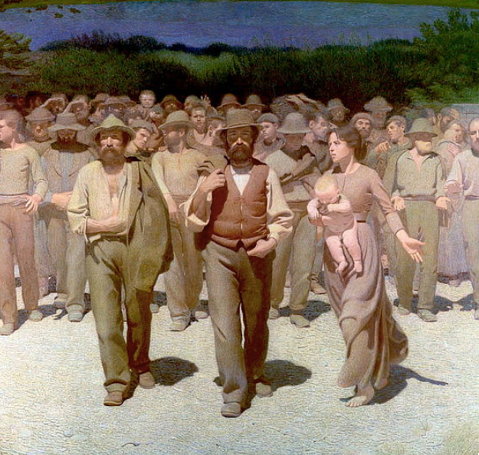
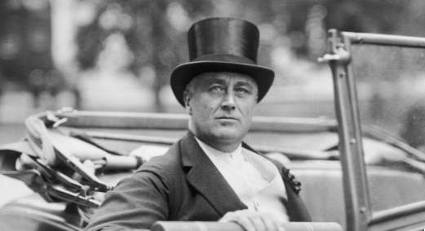
Really-Existing Socialism
An ultimately unsuccessful challenger:
Ernest Gellner:
“Just as extreme Shi’ite Muslims hold that Archangel Gabriel made a mistake, delivering the Message to Muhammed when it was intended for Ali…
“so Marxists… think… [the] message was intended for classes, but was delivered to nations.
“It is now necessary for revolutionary activists to persuade the wrongful recipient to hand over the message and the zeal…”

Slide 17
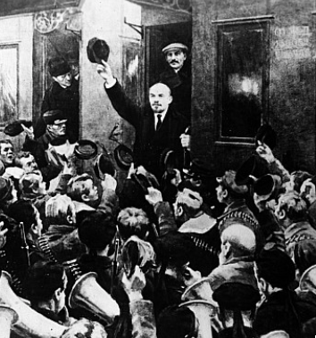
The Soviet Trajectory
Imperatives
Survive
Eliminate large-scale private property and market
Industrialize
No aid coming from Germany
War Communism
War Terror
NEP
“Scissors Crisis”
Capital as a business model
Nationalities question

Slide 18
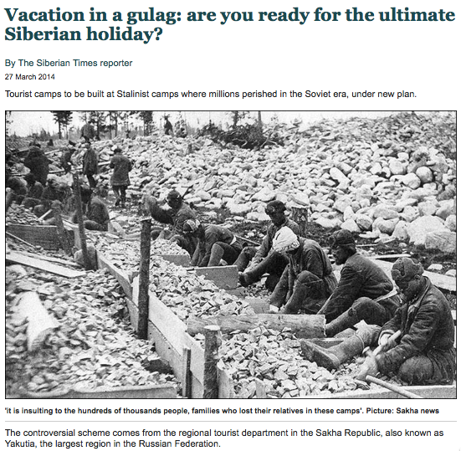
Failed Utopia: Social and Economic Organization
Max Weber: “Wherever bureaucracy gained the upper hand… it did not disappear…. State bureaucracy would rule alone if private capitalism were eliminated. The private and public bureaucracies, which now check one another to a degree, would be merged into a single hierarchy.

Slide 19
Failed Utopia: Social and Economic Organization
Max Weber:
“This would be similar to the situation in ancient Egypt, but it would occur in a much more rational—and hence unbreakable—form… the shell of bondage which men will perhaps be forced to inhabit as powerless as the fellahs of ancient Egypt. Who would want to deny that such a potentiality lies in the womb of the future?…”

Slide 20
The Soviet Union: Late Development
If the Soviet Union was “European” or “recent settlement”—an absolute disaster.
If you compare the Soviet Block to the countries around its edge—an absolute disaster
Why? Because bureaucracies undisciplined by markets are really not very good at organizing production
They can—sometimes—duplicate things they can see elsewhere
They can—sometimes—generate amazing feats of resource mobilization
While sharply reducing “profiteering”
When do we want “hard incentives”, anyway?

Slide 21
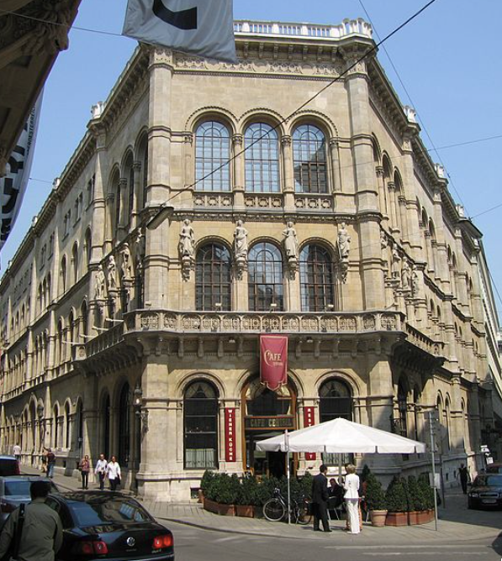
Failed Utopia: The Costs of the “Experiment”
Guenther Roth:
“Weber and Schumpeter... had their famous falling-out in a Viennese coffeehouse in 1918. Weber, ‘who took nothing lightly,’ and Schumpeter, who ‘took nothing hard,’ recalled Somary who witnessed the scene, clashed over the Russian Revolution….

Slide 22
Failed Utopia: The Costs of the “Experiment” II
Guenther Roth:
“Schumpeter welcomed it as a laboratory experiment…. For Weber it was going to be ‘a laboratory heaped with human corpses.’ When an enraged Weber stormed out, a smiling Schumpeter remarked: ‘How can someone carry on like that in a coffeehouse?’—the proper place for irony, never seriousness…”

Slide 23
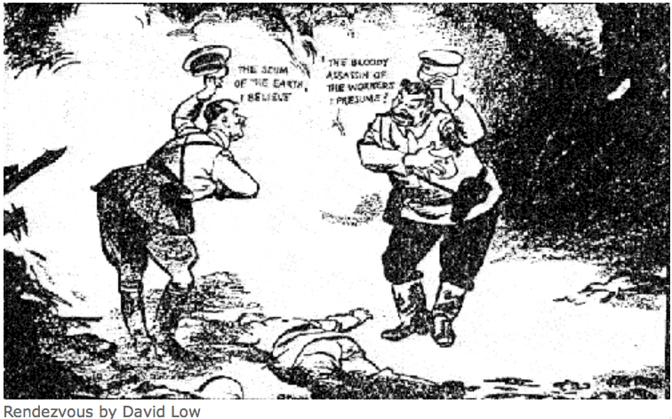
The Soviet Union: Tyranny
Should we dismiss the Soviet Union as simply a tyranny?
One in which the standard ways of bullying and oppressing people are reinforced by technologies of bureaucracy and indoctrination?
“Fake News” goes back to the Norman Conquest, after all…
We are just better at it…

Slide 24
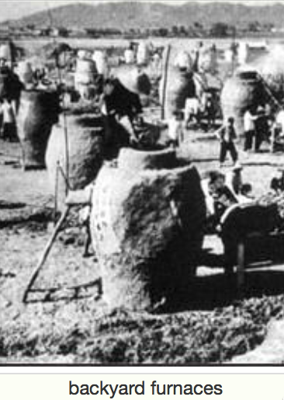
Failed Utopia: The Butcher’s Bill
Russian Civil War: 3M?
Collectivization of agriculture: 10M?
Great Terror: 2M?
Post-WWII purge: 2M?
Anti-landlordism: 4M?
Collectivization: 4M?
Great Leap Forward famine: 50M?
Cultural Revolution: 5M?
Pol Pot: 1.5M
Kim Dynasty: ????

Slide 25
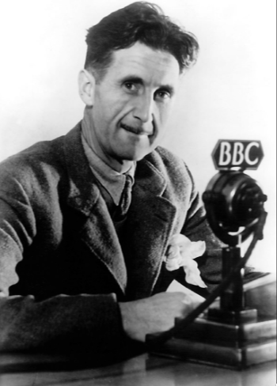
The George Orwell Tradition
George Orwell’s 1984
Estate-based authoritarianism as the natural Agrarian Age form of government
Totalitarianism as the natural Industrial Age form of government: “a boot stamping on a human face, forever…”
What is “totalitarianism”?
Is it possible?
Is it stable?
Is it a model?
Religious or quasi-religious fervor?
Cf.: Hobsbawm

Slide 26
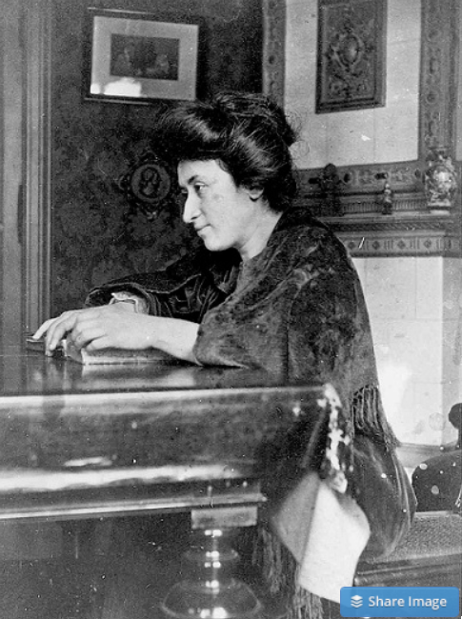
Failed Utopia: Politics
Rosa Luxemburg: “The tacit assumption underlying the Lenin-Trotsky theory of dictatorship is this: that the socialist transformation is something for which a ready-made formula lies completed in the pocket of the revolutionary party…. We [do] know more or less what we must eliminate…
“But when it comes to the nature of the thousand concrete, practical measures, large and small, necessary to introduce socialist principles into economy, law and all social relationships, there is no key in any socialist party program or textbook. That is not a shortcoming but rather the very thing that makes scientific socialism superior to the utopian varieties…”
What did Lenin do? The German war economy…

Slide 27
Failed Utopia: Politics II
Rosa Luxemburg: “In place of… general, popular elections, Lenin and Trotsky have laid down the soviets…. Public life gradually falls asleep, a few dozen party leaders of inexhaustible energy and boundless experience direct and rule… meetings… [that] approve proposed resolutions unanimously… the dictatorship of a handful of politicians…. Such conditions must inevitably cause a brutalization of public life: attempted assassinations, shooting of hostages, etc…”

Slide 28
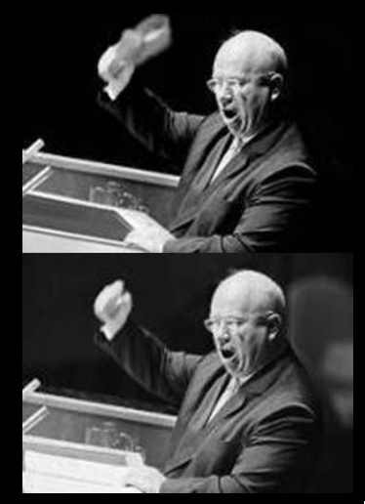
Failed Utopia: Our Friend Nikita Sergeyevitch
Francis Spufford: “So much blood, and only one justification for it…. If it had been all prologue, all only the last spasms of death in the old, cruel world…. Today the radio was reporting… Prague….
“He fumbled with the tape machine… found the RECORD key…. ‘Paradise’, he told the wheat field in baffled fury: ‘is a place where people want to end up, not a place they run from. What kind of socialism is that? What kind of shit is that, when you have to keep people in chains. What kind of social order? What kind of paradise?…’
“And then… the retired monster sat very still on the bench by the field…”

Slide 29
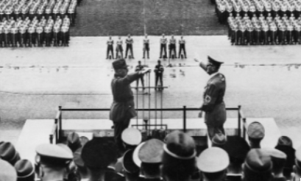
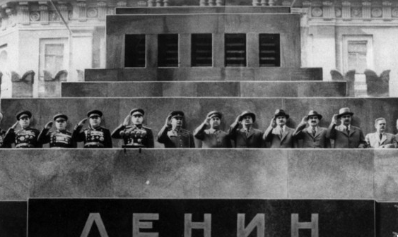
Would a Non-Authoritarian Communism Have Been So Bad?
John Maynard Keynes:
“Russian Communism… tries to construct a framework… in which pecuniary motives… shall have a changed relative importance…. Money-making…will simply not occur to a respectable young man as a possible opening, any more than the career of a gentleman burglar or acquiring skill in forgery and embezzlement….
“This system does not mean a complete leveling down of incomes…. The private trader is a sort of permitted outlaw, without privileges or protection…. The effect of these social changes has been, I think, to make a real change in the predominant attitude towards money…. Money-making and money-accumulating cannot enter into the life-calculations of a rational man who accepts the Soviet rule in the way in which they enter into ours….
“All this may prove Utopian, or destructive of true welfare, though, perhaps, not so Utopian, pursued in an intense religious spirit, as it would be if it were pursued in a matter-of-fact way.
“But is it appropriate to assume, as most of us have assumed hitherto, that it is insincere or wicked?…”

Slide 30
Takeaways from This Time
Alternatives: Lecture & Chs. 11 & 13
Give me five…

Slide 31
Preview
Fascism & WWII
Preview & review (5 min)
Administration (5 min)
Lecture: Continuing our look at mid-20th century alternatives to the ‘classical liberal’ laissez-faire order:
Fascism (10 min)
Adolf Hitler (10 min)
Review (20 min)
Lecture: WWII (20 min)
Takeaways from this lecture (5 min)
Preview of the next lecture (5 min)

Slide 32
Review: Takeaways from Last Time
From: Really-Existing Socialism
Give me three takeaways, & why they are important…

Slide 33
To Your iClickers
In the abortive German communist revolution of January 1919, Petty Officer Lemmgen and his forces failed to take control of the offices of the Ministry of War because:
Lieutenant Hamburger objected that the document authorizing him to do so was handwritten, and Lemmgen returned to Revolutionary HQ to get the document typed.
Lieutenant Hamburger objected that the document authorizing him to do so was not signed, and Lemmgen returned to Revolutionary HQ to get the document signed.
Lieutenant Hamburger objected that the Revolutionary Council that had produced the document was a bunch of traitors.
Lieutenant Hamburger objected that the Revolutionary Council was only made up of a minority of the leaders of the German Socialist Party.
None of the above.

Slide 34
Econ 115: Administration: Office Hours &c.
DeLong: Office Hours
M 11:10-12:40, Blum Hall 200B
T 11:15-12:00, Blum Hall 200B
By appointment in Blum Hall 200B, Evans 691A, or elsewhere: email <delong@econ.berkeley.edu> Sign up at: <https://www.icloud.com/numbers/0leoOOlezWp6BYKSiPJhdXy7Q>
Read: DeLong, chapter 11 & 12
Slides: <https://github.com/braddelong/public-files/blob/master/econ-115-lecture-8.pptx>
Do: Understanding the Great Depression <https://bcourses.berkeley.edu/courses/1487684/assignments/8052000>; due Mar 8
Memo: bCourses website <https://bcourses.berkeley.edu/courses/1487684>

Slide 35
Fascism
Communism and Fascism: The Same or Different?
Felipe Fernandez-Armesto:
“From the perspective of the future, the differences among all forms of violent political extremism will blur.... Individuals moved between fascism and militant socialism as if by connecting channels. Mussolini was a socialist youth leader before he became a fascist duce....
“Many Nazis tried to make the party conform to its name: the National Socialist German Workers’ Party. Britain's [fascist leader], Oswald Mosley, was a socialist cabinet minister before he took to the streets....
“My father... carried a communist card and wore a [fascist] Falangist uniform [in Spain] at different moments in the 1930s…”
Is this fair?
Perhaps not…

Slide 36
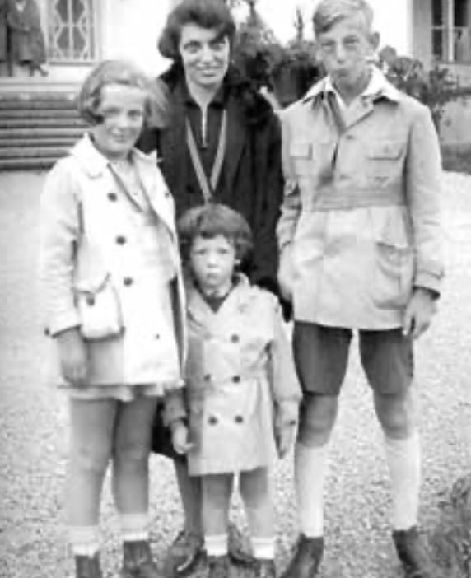
Fascism
Communism and Fascism: The Same or Different?
But perhaps it is fair…
Lifelong communist Eric Hobsbawm:
“To be a social revolutionary increasingly meant to be a… member or supporter of some Moscow-aligned Communist party.... Nobody else within sight offered both to interpret the world and to change it…. The communist movement…its unity, cohesion, and its striking immunity to fission, it was… the only game in town....
“Lenin’s ‘party of a new type’ [was] a formidable innovation of twentieth-century social engineering.... The party could command extraordinary devotion and self-sacrifice from its members, more than military discipline and cohesiveness, and a total concentration on carrying out party decisions at all costs.
“This impressed even hostile observers profoundly…”
This does not sound like Hobsbawm thinks he joined:
a movement that would change the world
because its intellectual mastery of the key to the riddle of history
gave it a lever
with which a small group could reshape the world for the best
This sounds, instead, like some fascist Triumph des Willens—a weak adolescent male convinced that joining a group that does stupid things makes him strong
But his attitude lasted Hobsbawm’s entire life…

Slide 37
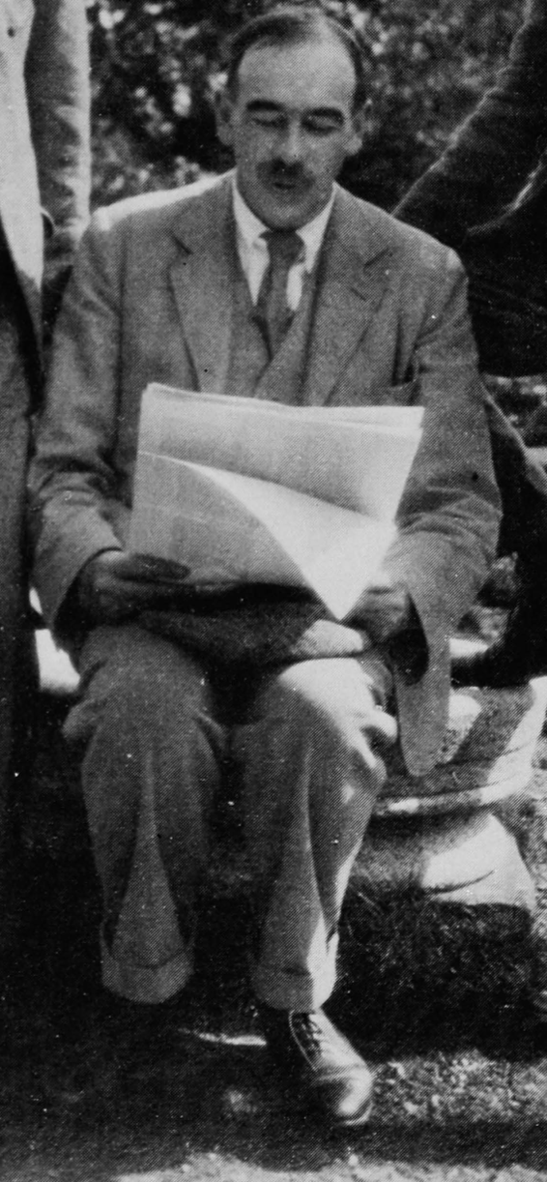
John Maynard Keynes’s Critique
General Theory, chapter 24:
Within this field the traditional advantages of individualism will still hold good…. The advantages to efficiency of the decentralisation of decisions and of individual responsibility is even greater, perhaps, than the nineteenth century supposed….
“Above all, individualism… is the best safeguard of personal liberty… widens the field for the exercise of personal choice… the best safeguard of the variety of life… the loss of which is the greatest of all the losses of the homogeneous or totalitarian state…. This variety preserves the traditions which embody the… successful choices of former generations… colours the present with the diversification of its fancy… and, being the handmaid of experiment… is the most powerful instrument to better the future….
“The authoritarian state systems of today seem to solve the problem of unemployment at the expense of efficiency and of freedom…. It may be possible by a right analysis of the problem to cure the disease whilst preserving efficiency and freedom…”
Review of Leon Trotsky:
“Granted his assumptions, much of Trotsky’s argument is, I think, unanswerable. Nothing can be sillier than to play at revolution…. [But] Trotsky’s book must confirm us in our conviction of the uselessness, the empty-headedness of Force at the present stage of human affairs…. We lack more than usual a coherent scheme of progress, a tangible ideal. All the political parties alike have their origins in past ideas and not in new ideas—and none more conspicuously so than the Marxists. It is not necessary to debate the subtleties of what justifies a man in promoting his gospel by force; for no one has a gospel. The next move is with the head, and fists must wait…”
A Short View of [Communist] Russia:
“There are three questions to answer. Is the new religion partly true, or sympathetic to the souls of modern men? Is it on the material side so inefficient as to render it incapable to survive? Will it, in the course of time, with sufficient dilution and added impurity, catch the multitude?… I sympathise with those who seek for something good in Soviet Russia. But … for me… Red Russia holds too rnuch which is detestable…. I am not ready for a creed which does not care how much it destroys the liberty and security of daily life, which uses deliberately the weapons of persecution, destruction, and international strife… suborn[s] spies in every family and group…. Perhaps this is no worse and has more purpose than the greedy, warlike, and imperialist propensities of other governments; but it must be far better than these to shift me out of my rut.
“How can I accept a doctrine which sets up as its bible, above and beyond criticism, an obsolete economic textbook which I know to be not only scientifically erroneous but without interest or application for the modern world?…”

Slide 38
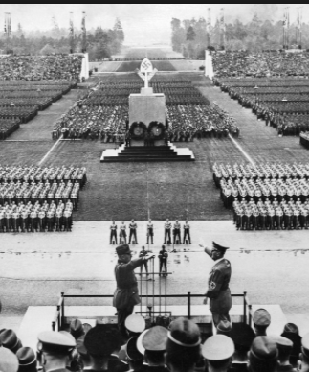
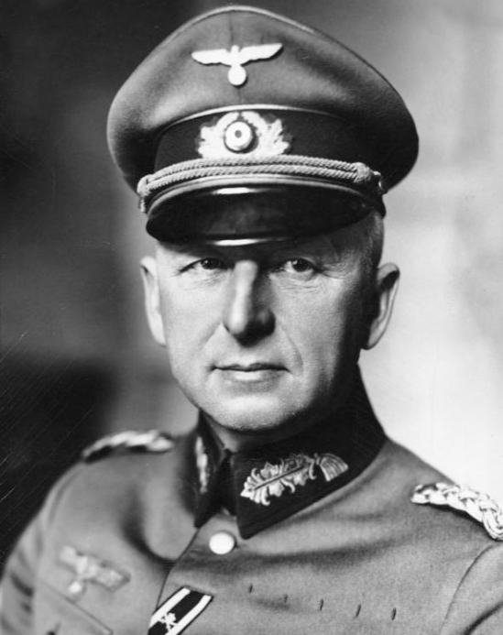
Origins of Fascism
The fasces in republican Rome
Mussolini:
The first united-and-tied-together-we-are-powerful-like-a-bundle-of-sticks guy
Started out as socialist agitator: editor of Avanti!
Socialists flummoxed by the start of WWI
Austrian socialist Victor Adler: the working classes like the idea of WWI, and: “It is better to be wrong with the working classes than right against them”
Only Hasse, Luxemburg, Leibknecht, and Lenin stuck to their pacifist guns
Mussolini & Lenin both unmanned by the collapse of pacifist socialism in 1914
Lenin: the working class needs to be guided by a party of a new type
Mussolini: I want to be at the head of the parade—and if the parade is a nationalist parade, so be it…
Il Popolo d’Italia
The “Fascist” party

Slide 39
What Was Fascism Going to Be?
Mussolini had a name and a cause
Fascism and nationalism
But he did not have a doctrine or a philosophy
Feeling his way forward
Fascism as critique: the Victorian-Edwardian order had:
Failed in macroeconomic management
Failed in producing a just income distribution (but seen not in class, but in nation and minority terms)
Arms-length self-interested exchange a failed model of society
Cosmopolitanism a failed model of reality
Parliamentary democracy a failed system of government
Real? Or just a con game?

Slide 40
Key Elements of Fascism
A belief in leaders: good politics sees not representatives expressing the desires of those below; but leaders who command; the goals of a country are imposed by leaders of vision from above.
The cretinism of parliaments: Composed of time-servers, corrupt distributors of favors to special interests, or ideological champions, they are simply incompetent to handle the problems of modern life.
A belief in the value of a strong and unified nation: the willing and eager sacrifice of individual goals and lives to strengthen the national purpose, with war and expansion as tests of strength and arenas for heroic sacrifice.
“Coordination and propaganda”: advertising, ceremonies, the ruling party as an enforcer of social discipline and respect for the leader.

Slide 41
Key Elements of Fascism II
A belief in at least some traditional hierarchies: the army, the family, sometimes the church.
A hatred of social justice warriors: socialists as opponents of national self-assertion (and as potential betrayers of the people to slavery under a foreign—usually Jewish or Communist or Russian or all three elite); liberals as unwilling to take the steps necessary to fight socialists, as self-absorbed individualists who weakened the nation, and as parliamentarians who did not recognize that the nation, not the individual, held rights.
A hatred of Jews: rootless cosmopolitans uninterested in the ethnic or national identity and destiny; thieves and deceivers to boot; people who made their money through financial manipulation rather than heroic feats of engineering and construction.
Unity is achieved through demonizing enemies: political order not as contract, cooperation, or fellowship—but as war against “others”, our of which the only true fellowship can grow

Slide 42
Adolf Hitler: His Rise to Power
Adolf Hitler rose to power as an anti-communist who had a plan:
to deal with the Great Depression
to deal with German subservience to the World War I Allied powers
to deal with the “November criminals”, the Jews, and the other enemies of the German Volk
to turn Germans into a Herrenvolk
The only politician who was charismatic, conservative, populist, and a man-with-a-plan
He rose to power because he was all four
No Great Depression, no Nazi state

Slide 43
The Consolidation of the Weimar Republic by 1928
The second saddest book on my bookshelf: Hugh Quigley & Robert Clark (1928): Republican Germany: A Political and Economic Study:
“The consolidation of the German [Weimar] Republic is in itself a theme of the most absorbing interest....
“The fifth and probably last act is now being played, and promises something… heartening….
“The real consummation will probably be reached—namely, the recognition of the German Republic as a permanent feature in German history and its economic and political relations, and, with it, the opening of a new era of international prosperity….

Slide 44
No Great Depression, No Nazi State
Quigley and Clark’s—long—book contains three mentions of Adolf Hitler:
a passing reference to the “Hitler incident”,
a half- page narrative of Hitler’s unsuccessful 1923 attempt to take over the Bavarian provincial government via a coup
“Bavaria… was an armed camp… organizations for military training and (what was more deadly) secret societies in morality and mentality far more akin to the worst traditions of medievalism than to those of the twentieth century…. The movement dominated by the military element… was illumined by the names of Ludendorff and Hitler…”
Writing in 1928, five years before Hitler was to take power and destroy the German Republic, Adolf Hitler is simply not a big deal to two people writing a political and economic survey of Germany…

Slide 45
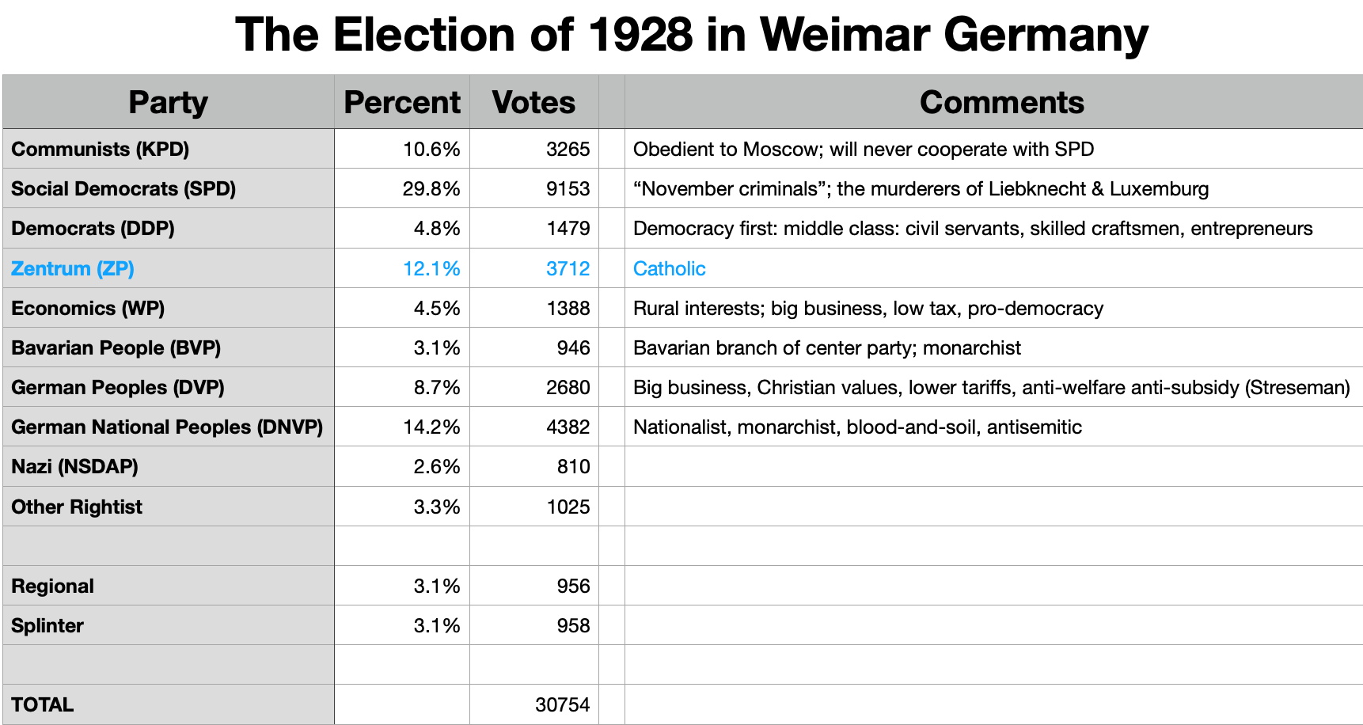
The 1928 Election
On the left, the Communists
They will not—after the murder of Luxemburg & Leibknecht in the suppression of the 1919 Spartakist uprising—cooperate with the Social Democrats
They will do whatever Moscow says
Social Democrats thus not a natural party of government, but can hold power only by acquiescing in “lesser evil” policies of coalition partners
Democrats, (Catholic) Center, WP, & (Bavarian Catholic) Center can look either left or right for coalition partners—they are the natural parties of government
The monarchist DNVP anchors the right…
Unclear whether it should cooperate with the government, or not
Then there are the “fringe”, with 12.1% of the vote
The Nazis are in the “fringe”

Slide 46
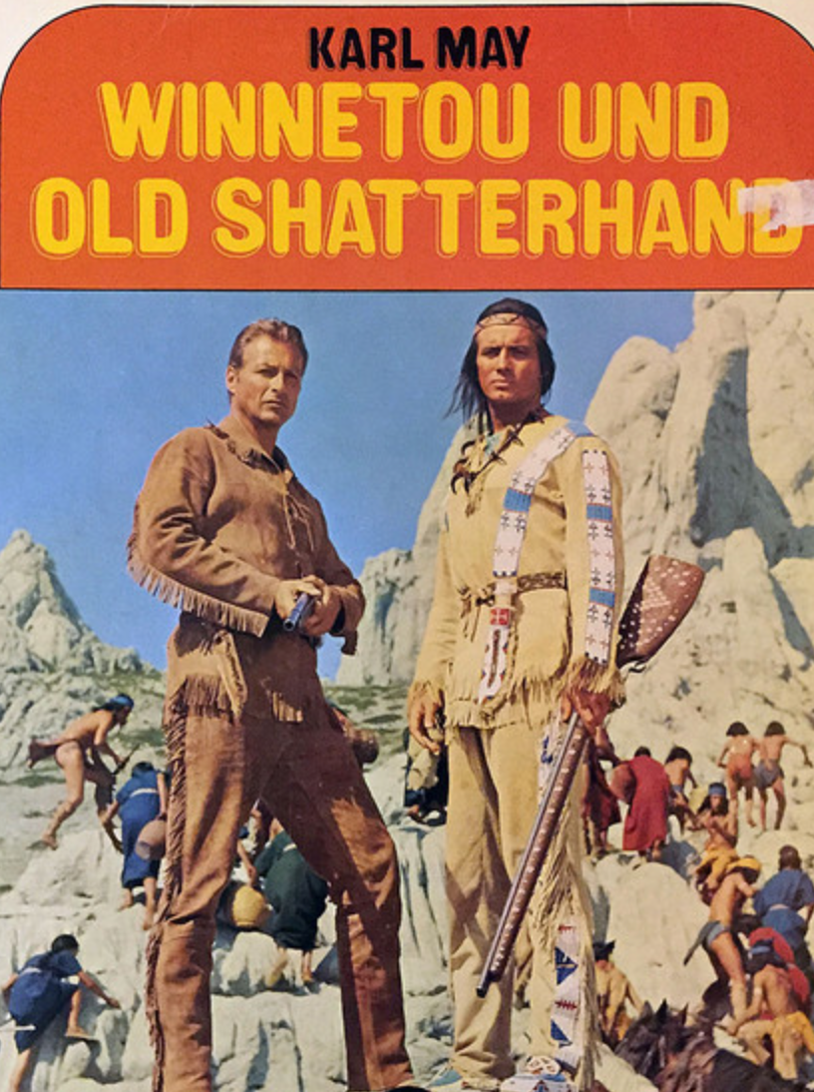
Adolf Hitler’s Malthusianism
How to turn Germans into a Herrenvolk?
Adolf Hitler really hated Jews
Adolf Hitler had read too many cowboy novels by Karl May
Adolf Hitler took Malthus very seriously:
“Germany has an annual increase in population of nearly nine hundred thousand souls. The difficulty of feeding this army of new citizens must grow greater from year to year and ultimately end in catastrophe.... There were four ways of avoiding so terrible a development…”

Slide 47
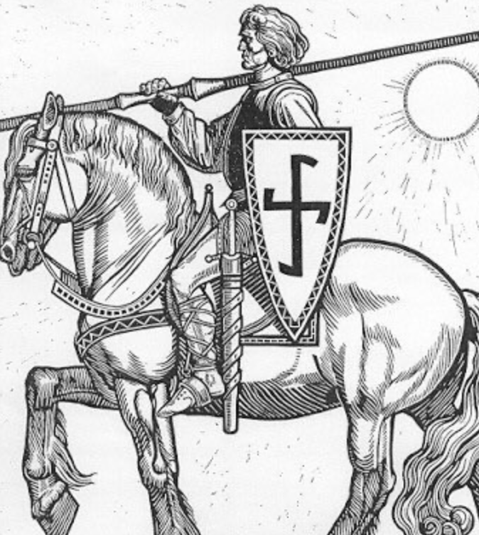
Four Ways Out…
Birth control? That’s worse…
Agricultural productivity? Limited effect…
Export manufactures? “Unhealthy”—and incredibly risky given the British fleet…
“Living space”: Conquest and demographic replacement
Germany in a long-run fight for world domination with:
Britain
Russia
America
China? India?

Slide 48
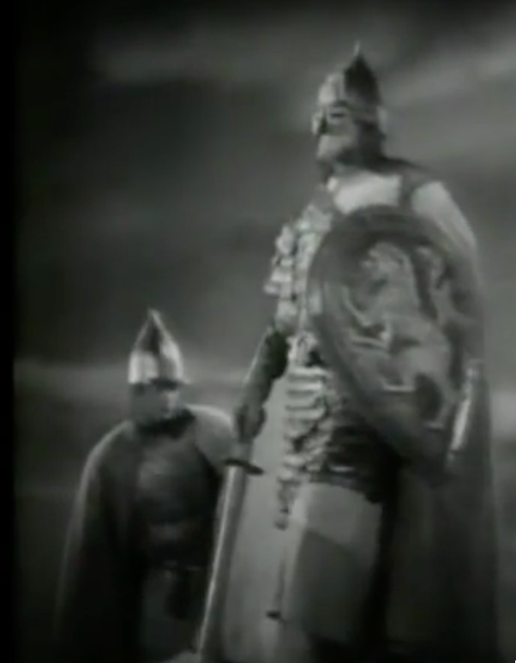
Drang nach Osten!
Adolf Hitler:
“We must... coolly and objectively adopt the standpoint that it can certainly not be the intention of Heaven to give one people fifty times as much land and soil in this world as another.... We must not let political boundaries obscure for us the boundaries of eternal justice….
“The law of self-preservation goes into effect; and what is refused to amicable methods it is up to the fist to take… If land was desired in Europe, it could be obtained by and large only at the expense of Russia….
“The new Reich must again set itself on the march along the road of the Teutonic knights of old, to obtain by the German sword sod for the German plow and daily bread for the nation…”

Slide 49
Drang nach Osten! II
Max Weber, a German liberal:
“The German character of the East [is] something that should be protected…. Our state is a national state, and... we have a right to make this demand…. The economic struggle between the nationalities follows its course even under the semblance of 'peace'. The German peasants and day-labourers of the East are… getting the worst of it in the silent and dreary struggle of everyday economic existence… abandoning their homeland to a race which stands on a lower level….
“Here can be no truce even in the economic struggle for existence…. Certainly the vulgar conception of political economy is that it consists in working out recipes for making the world happy…. However [reality] prevents us from imagining that… elbow-room in this earthly existence can be won in any way than through the hard struggle.... The question... is not 'how will human beings feel in the future' but 'how will they be'....
“We do not want to train up feelings of well-being in people, but rather those characteristics we think constitute the greatness and nobility of our human nature….
“Our successors will not hold us responsible before history for the kind of economic organization we hand over to them, but rather for the amount of elbow-room we conquer for them in the world…”
Erich von Manstein, nee von Lewinsky…

